Slide 1
Topic 5 –
Intellectual Property
MPU32213
Computer Ethics and Professional Responsibility
Oct 2017
MPU32213-SE-Oct2017

Slide 2
Topics covered
Intellectual Property (IP) and Changing Technology
Copyright Law and Significant Cases
Copying and Sharing
Search Engines and Online Libraries
Free-Speech Issues
Free Software
Issues for Software Developers
MPU32213-SE-Oct2017
Notes:
We will explore the issues about intellectual property (IP) by explaining the concept of IP and reviewing principles of copyright law.
This chapter concentrates more on copyright than other forms of IP because digital technology and the Internet affect copyright so strongly.
We will also discuss patent issues for software and Web technologies as they have become quite important.

Slide 3


Intellectual Property and Changing Technology
What is Intellectual Property?
The intangible creative work, not its particular physical form
Value of intelligence and artistic work comes from creativity, ideas, research, skills, labor, non-material efforts and attributes the creator provides
Protected by copyright and patent law
Every intellectual property is one-of-a-kind.
Copying a piece of intellectual property is different from stealing a physical object.
MPU32213-SE-Oct2017
Notes:
Why is IP given legal protection?
First, what is IP? Things that get protected is the “intangible creative work”.
Ex. 1 - You buy a novel (physical book). You may give it away to a friend, lend it or resell the physical book.
The principle is the owner of the intangible book, that is, the owner of the copyright. [Similar for software, music, movie etc]
Ex. 2- When we buy a movie on DVD, we are buying 1 copy with the right to watch it but not to play it in a public venue or charge a fee.
Ex. 3 – We buy a software package, we only buy only a copy of it or a license to use the software.

Slide 4

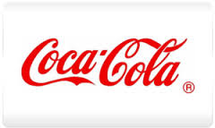
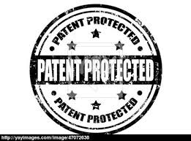
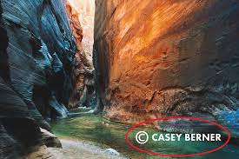
Different ways to protect IP
Trade secrets
  formulas, processes, proprietary designs, strategic plans, customer lists, etc
Trademarks - identification of goods
  Word, symbol, picture, sound, or color
Patents
  public document to describe the invention
Copyrights
  authors with certain rights to
  original works
MPU32213-SE-Oct2017
Notes:
Intellectual property – any unique product of the human intellect that has commercial value
Trade secret – Confidential piece of intellectual property that gives company a competitive advantage
Never expires
Not appropriate for all intellectual properties
Patent – A public document that provides detailed description of invention
Provides owner with exclusive right to the invention
Owner can prevent others from making, using, or selling invention for 20 years

Slide 5
The IP Chain of Activities
Creation
Innovation
Commercialization
Protection
Enforcement
MPU32213-SE-Oct2017
Notes:
Intellectual property requires legal protection based on the same principles that pertain to protecting ownership of physical property that we own (a basic liberty or negative right).
Intellectual and artistic creations also consume labor, ideas, skills and research to create, just like material products; and therefore have the same kind of value and deserve the same kind of protection.

Slide 6
Intellectual Property and Changing Technology
What is Intellectual Property? (cont.)
Copyright holders have exclusive rights:
  To make copies
  To produce derivative works, such as translations into other languages or movies based on books
  To distribute copies
  To perform the work in public (e.g. music, plays)
  To display the work in public (e.g. artwork, movies, computer games, video on a Web site)
MPU32213-SE-Oct2017
Notes:
U.S. Copyright law (Title 17 of the U.S. Code)
Has some exceptions [“fair use” doctrine – discuss later]
Restaurants, bars, shopping centers, and karaoke venues pay FEES for the copyrighted music they play.
Movie makers pay for the right to base a movie on a book, even if they make significant changes to the story.
Taking IP is different from theft of theft of physical property, and copyright law does not prohibit ALL unauthorised copying, distribution and so on.

Slide 7
Intellectual property: benefits
Challenges of New Technology:
Digital technology and the internet has made copyright infringement easier and cheaper
New compression technologies have made copying large files (e.g. graphics, video and audio files) feasible
New tools allow us to modify graphics, video and audio files to make derivative works
Scanners allow us to change the media of a copyrighted work, converting printed text, photos, and artwork to electronic form.
MPU32213-SE-Oct2017
Notes:
Previous technologies – photocopiers made copying of printed material easy. but they were not as serious a threat as digital technology.
What other technological factors:
Sw tools for manipulating video and sound, enabling & encouraging non-professionals to create new works using the works of others.
Peer to peer technology permits easy transfer of files over the Internet
High volume, inexpensive digital storage media, such as hard disks, memory cards and etc

Slide 8
Intellectual property: benefits
Has both individual and social benefits:
  it protects the right of artists, authors, and inventors to compensation for what they create
  it encourages production of valuable, creative work that benefits society as a whole.
IP protection extends to the creative work
  purchaser of the distribution form owns the form and some limited use of the creative work
MPU32213-SE-Oct2017
Notes:
The author of a particular piece of intellectual property, or his or her employer (e.g. newspaper or a software company), may transfer the copyright to a publisher, a music recording company, a movie studio, or some other entity in return for some remuneration.
Copyrights last for a limited time—for example, the lifetime of the author plus 70 years.
After that, the work is in the public domain; anyone may freely copy and use it.

Slide 9
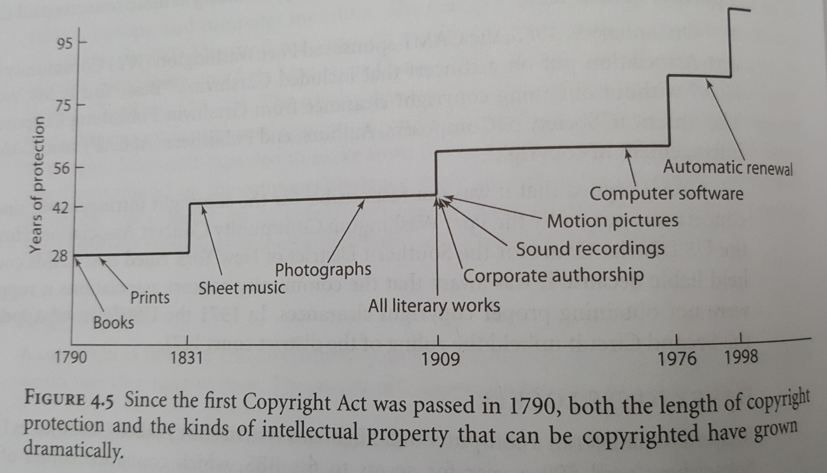
Copyright creep
MPU32213-SE-Oct2017
Notes:
See next slide for explanation

Slide 10
US copyright law
A bit of history:
1790 first copyright law passed
1909 Copyright Act of 1909 defined an unauthorized copy as a form that could be seen and read visually
1976 and 1980 copyright law revised to include software and databases that exhibit "authorship" (original expression of ideas), included the "Fair Use Doctrine"
1982 high-volume copying became a felony
1992 making multiple copies for commercial advantage and private gain became a felony
MPU32213-SE-Oct2017
Notes:
Felony - A crime regarded in the US and many other judicial systems as more serious than a misdemeanour.

Slide 11
US copyright law
A bit of History (cont.):
1997 No Electronic Theft Act made it a felony to willfully infringe copyright by reproducing or distributing one or more copies of copyrighted work with a total value of more than $1,000 within a six-month period
1998 Digital Millennium Copyright Act (DMCA) prohibits making, distributing or using tools to circumvent technological copyright protection systems and included protection from some copyright lawsuits for Web sites where users post material
2005 Congress made it a felony to record a movie in a movie theater
MPU32213-SE-Oct2017
Notes:
Felony - A crime regarded in the US and many other judicial systems as more serious than a misdemeanour.

Slide 12
Cyber Law In Malaysia
In 1997, Malaysia Government provides an inclusive framework to deal with the problems and crimes which related to the information devices and technologies. There are eight cyber law:
  Digital Signature Act 1997
  Computer Crimes Act 1997
  Telemedicine ACT 1997
  COMMUNICATIONS AND MULTIMEDIA ACT 1998 (CMA)
  Malaysian Communications and Multimedia Commission Act 1998
  The Copyright (Ammendment) Act 1997
  Electronic Commerce Act 2006
  OPTICAL DISC ACT 2000
  Electronic Government Activities Act 2007
  Personal Data Protection Act 2010
  Trade Description Act 1972.
MPU32213-SE-Oct2017
Notes:
Law 1 – 3, 7 : Topic 6 Crimes
Law 4?
Law 5?
Law 6 – topic 5 IP
Law 10?

Slide 13
Digital Signature Act 1997
The Digital Signature Act 1997 secures electronic communications especially on the Internet. Digital Signature is an identity verification standard that uses encryption techniques to protect against e-mail forgery. The encrypted code consists of the user’s name and a hash of all the parts of the message.
MPU32213-SE-Oct2017
Notes:
Will discuss in detail in Topic 6 – Crime
Slide 13-24 will be discussed in Topic 6

Slide 14
Computer Crimes Act 1997
The Computer Crimes Act 1997 gives protection against the misuses of computers and computer criminal activities such as unauthorised use of programmes, illegal transmission of data or messages over computers and hacking and cracking of computer systems and networks.
MPU32213-SE-Oct2017
Notes:
Will discuss in detail in Topic 6 – Crime

Slide 15
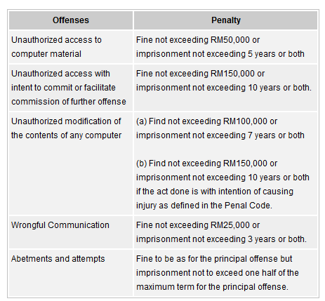
Computer Crimes Act 1997
MPU32213-SE-Oct2017
Notes:
Will discuss in detail in Topic 6 – Crime

Slide 16
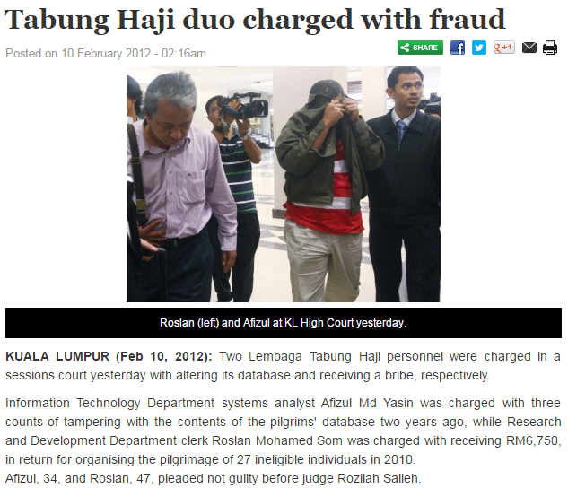
Significance Cases
On February 9, 2012, a system analyst with the Lembaga Tabung Haji's Information Technology Department was charged under Section 5(1) of the Computer Crimes Act 1997 for three counts of tampering with the contents of the pilgrims' database between June and July 2010. In May 2014, he was found guilty of the charge and sentenced to three year's jail and fined a total of RM60,000, in default of eight months' jail.
Source:
http://www.thesundaily.my/news/291106
MPU32213-SE-Oct2017

Slide 17
Significance Cases
On September 8, 2008, an information technology officer with the Ministry of Natural Resources and Environment in Putrajaya was charged under Section 5(1) of the Computer Crimes Act 1997 for four counts of illegally transferring land titles in Perak. If found guilty, he is liable to a fine not exceeding RM100,000 or to a jail term of not more than seven years, or both.
At one proceeding in a session court in Ipoh, a man has been charged with four counts relating to an illegal transfer of land titles. The man is charged under section 5(1) of the Computer Crimes Act 1997 that makes it an offence to modify contents of a computer or computer system without authority. The accused claims trial and the case will be mentioned on 9 Oct 2008.
MPU32213-SE-Oct2017

Slide 18
Telemedicine Act 1997
The Telemedicine Act 1997 ensures that only qualified medical practitioners can practice telemedicine and that their patient's rights and interests are protected. These act provides the future development and delivery of healthcare in Malaysia.
MPU32213-SE-Oct2017

Slide 19
Communications And Multimedia Act 1998
The implementation of Communication and Telecommunication Act 1998 ensures that information is secure, the network is reliable and the service is affordable all over Malaysia. This Act also ensures high level of user's confidence in the information and communication technology industry.
MPU32213-SE-Oct2017

Slide 20
Malaysian Communications and Multimedia Commission Act 1998
It is an Act to provide for the establishment of the Malaysian Communication and Multimedia Comission, with power to supervise and regulate the communications and multimedia activities in Malaysia to enforce the communications and multimedia laws of Malaysia and for related matters.
MPU32213-SE-Oct2017

Slide 21
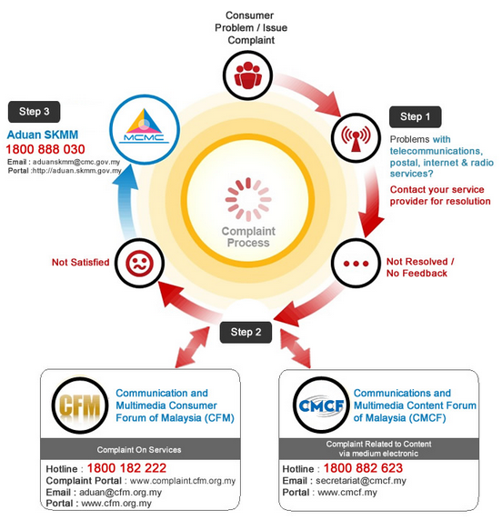
Cyber Law In Malaysia – Report the Complaint
MPU32213-SE-Oct2017

Slide 22
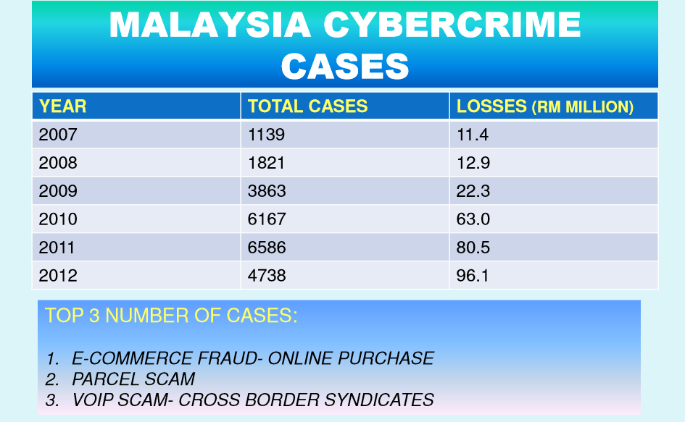
Source: DSP Mahfuz Bin Dato' Ab. Majid. Royal Malaysia Police, http://www.skmm.gov.my/skmmgovmy/media/General/pdf/DSP-Mahfuz-Majid-Cybercrime-Malaysia.pdf
MPU32213-SE-Oct2017

Slide 23
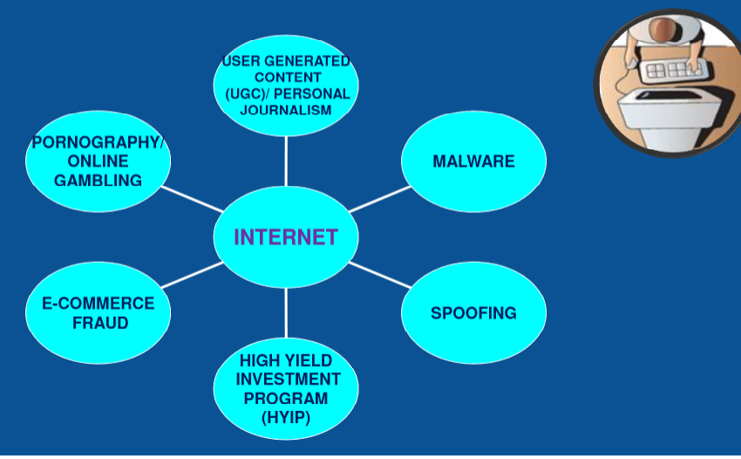

Computer Crime in Malaysia
Source: DSP Mahfuz Bin Dato' Ab. Majid. Royal Malaysia Police, http://www.skmm.gov.my/skmmgovmy/media/General/pdf/DSP-Mahfuz-Majid-Cybercrime-Malaysia.pdf
MPU32213-SE-Oct2017

Slide 24
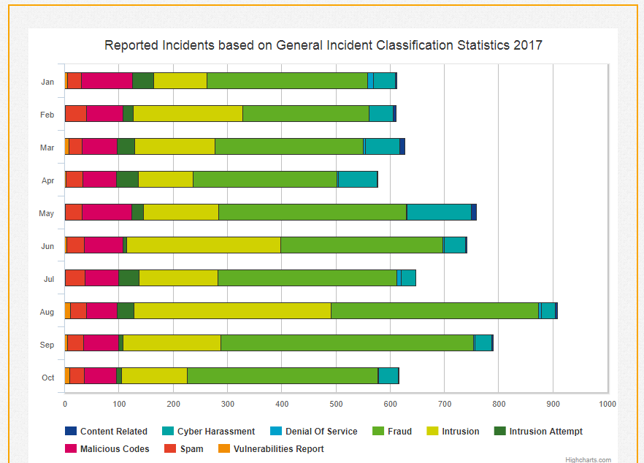
Source: MyCERT (Malaysia Computer Response Team) https://www.mycert.org.my/statistics/2017.php
UECS3313-SE-Oct2017

Slide 25
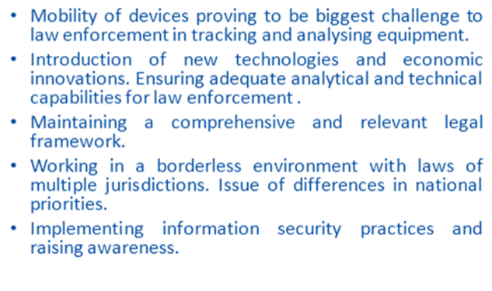
Technology challenges in crime investigation
MPU32213-SE-Oct2017
Source: DSP Mahfuz Bin Dato' Ab. Majid. Royal Malaysia Police, http://www.skmm.gov.my/skmmgovmy/media/General/pdf/DSP-Mahfuz-Majid-Cybercrime-Malaysia.pdf

Slide 26
Copyright
The subject matter of copyright is usually described as 'literary and artistic works,' that is, original creations in the fields of literature and arts.
The form in which such works are expressed may be words, symbols, music, pictures, three-dimensional objects, or combinations thereof.
MPU32213-SE-Oct2017

Slide 27
Copyright
The right to reproduce the copyrighted work
The right to distribute copies of the work to the public.
The right to display copies of the work in public.
The right to perform the work in public.
The right to produce new works derived from the copyrighted work.
MPU32213-SE-Oct2017
Notes:
Same as Slide 6

Slide 28
Copyright Law and Significant Cases (cont.)
Significant Cases:
Sony (Betamax System, VCR) v. Universal City Studios (1984)
  Supreme Court decided that the makers of a device with legitimate uses should not be penalized because some people may use it to infringe on copyright
  Supreme Court decided copying movies for later viewing was fair use
  Arguments against fair use
    People copied the entire work for later view.
    Movies are creative, not factual.
MPU32213-SE-Oct2017
Notes:
2 movie studios used Sony for contributing to copyright infringement because some customers used its Betamax video cassette recording machines to record movies shown on TV.
This case raised the important issue of whether copyright owners can sue makers of copying equipment because some buyers use the equipment to infringe copyright.
The “copied” movies were for a private, noncommercial purpose, and the movie studios could not demonstrate that they suffered any harm.

Slide 29
Copyright Law and Significant Cases (cont.)
Significant Cases (cont.):
Sony v. Universal City Studios (1984) (cont.)
  Arguments for fair use
    The copy was for private, noncommercial use and generally was not kept after viewing
    The movie studios could not demonstrate that they suffered any harm
    The studios had received a substantial fee for broadcasting movies on TV, and the fee depends on having a large audience who view for free
MPU32213-SE-Oct2017

Slide 30
Copyright Law and Significant Cases (cont.)
Significant Cases (cont.):
Sharing music: the Napster case v. A&M Records
Was the sharing of music via Napster fair use?
Napster's arguments for fair use
  The Sony decision allowed for entertainment use to be considered fair use
  Did not hurt industry sales because users sampled the music on Napster and bought the CD if they liked it
Source: http://www.academia.edu/6744047/Napster_Case_Analysis
MPU32213-SE-Oct2017
Notes:
Napster’s case
Review the fair use guidelines and how they apply.
Both cases can be found on Saraas Base, Chapter 4.
Napster was the name given to two music-focused online services. It was founded as a pioneering peer-to-peer (P2P) file sharing Internet service that emphasized sharing digital audio files, typically audio songs, encoded in MP3 format. The company ran into legal difficulties over copyright infringement.

Slide 31
Copyright Law and Significant Cases (cont.)
Significant Cases (cont.):
Sharing music: the Napster case (cont.)
RIAA's (Recording Industry Association of America) arguments against fair use
  "Personal" meant very limited use, not trading with thousands of strangers
  Songs and music are creative works and users were copying whole songs
  Claimed Napster severely hurt sales
Court ruled sharing music via copied MP3 files violated copyright
MPU32213-SE-Oct2017

Slide 32
Copyright Law and Significant Cases (cont.)
Significant Cases (cont.):
Sharing music: the Napster case (cont.)
RIAA's arguments
  Companies are required to make an effort to prevent copyright violations and Napster did not take sufficient steps
  Napster was not a device or new technology and the RIAA was not seeking to ban the technology
Court ruled Napster liable because they had the right and ability to supervise the system, including copyright infringing activities
MPU32213-SE-Oct2017

Slide 33
Copyright Law and Significant Cases (cont.)
Significant Cases (cont.):
Sharing music: the Napster case (cont.)
Was Napster responsible for the actions of its users?
Napster's arguments
  It was the same as a search engine, which is protected under the DMCA (Digital Millennium Copyright Act)
  They did not store any of the MP3 files
  Their technology had substantial legitimate uses
MPU32213-SE-Oct2017

Slide 34
Copyright Law and Significant Cases
Google Books –scan a million of books and creates a database containing the words contained in the books.
Five major publishers sued Google.
Reached out settlement:
  Allowing readers to search through them and preview them online.
  U.S.colleges and universities would have the opportunity to purchase subscriptions that would enable their students to gain online access to the collections of some of the world’s greatest libraries.
  Authors and publishers would receive payments earned from the online access of their books, fees paid when people printed pages from their books, and advertising revenues.
MPU32213-SE-Oct2017

Slide 35
WHAT THE COPYRIGHT ACT 1987 PROVIDES?
Copyright protection in Malaysia is governed by the Copyright Act 1987 which provides comprehensive protection for copyrightable works. The Act outlines the nature of works eligible for copyright (which includes computer software), the scope of protection, and the manner in which the protection is accorded.
A unique feature of the Act is the inclusion of provisions for enforcing the Act, which include such powers to enter premises suspected of having infringing copies and to search and seize infringing copies and contrivances. A special team of officers is appointed to enforce the Act.
Malaysia is a signatory of the Berne Convention. Foreign works of non-Berne member countries are also protected if they are made in Malaysia and are published in Malaysia within thirty days of their first publication in the country of origin.
MPU32213-SE-Oct2017
Notes:
The Berne Convention for the Protection of Literary and Artistic Works is an international treaty that refers to the concept and necessity of providing for an international copyright regulations and statutes.
The inception of the Berne Convention was born out the necessity for the ability of copyright legislation and regulations to be able to be interpreted and applied at an international level, and most importantly, between countries
Before the Convention, countries would often refuse to recognize foreign copyright of works, and reproduced and distributed such works freely.
https://copyright.laws.com/international-copyright/berne/berne-convention-overview

Slide 36
WHY THE COPYRIGHT (AMENDMENT) ACT 1997 ?
Information technology has challenged the traditional concept of copyright protection.
The Amendment Act, which amended the Copyright Act 1987, came into force on the 1st April 1999. This Act seeks to update the law on copyright.
Amongst other things, the Amendment Act makes unauthorized transmission of copyright works over the Internet an infringement of copyright.
The definition of a literary work now includes table or compilations "whether or not expressed in words, figures or symbols and whether or not in a visible form". The owner of copyright in a work including a derivative work, will have the exclusive right to control "the transmission of a work through wire or wireless means to the public, including the making available of a work to the public in such a way that members of the public may access the work from a place and at a time individually chosen by them".
MPU32213-SE-Oct2017

Slide 37
WHY THE COPYRIGHT (AMENDMENT) ACT 1997 (cont.)?
It is also an infringement of copyright to circumvent any effective technological measures aimed at restricting access to works, removal or alteration of any electronic rights management information without authority, or distribution, importation for distribution or communication to the public, without authority, works or copies of works in respect of which electronic rights management information has been removed or altered without authority.".
These provisions are aimed at ensuring adequate protection of intellectual property rights for companies investing in the IT and multimedia environment.
MPU32213-SE-Oct2017

Slide 38
WHO ENFORCES THE COPYRIGHT ACT (1987) ?
The Copyright Act (1987) provides for the enforcement of the law by the Ministry of Domestic Trade and Consumer Affairs, specifically the Enforcement Division, apart from the Police. The Act also provides the necessary clout to the enforcement agencies to effectively carry out anti-piracy measures.
The Malaysian Copyright Act provides for a Copyright Tribunal whose function is to grant Licenses to produce and publish in the National Language a translation of a literary work written in any other language. The Act is currently amended to expand the power of the tribunal to include arbitration of disputes relating to use of copyright works.
MPU32213-SE-Oct2017

Slide 39
WHAT WORK IS ELIGIBLE FOR PROTECTION UNDER THE COPYRIGHT ACT 1987 ?
A work that is eligible is fulfillment of the following conditions :
Sufficient effort has been expended to make the work original in character.
The work has been written down, recorded or reduced to material form.
The author is a qualified person or the work is made in Malaysia or the work is first published in Malaysia.
Works eligible for protection are:
Literary works
Musical works
Artistic works
Films
Sound recording
Broadcasts
Derivative works
Published editions
MPU32213-SE-Oct2017

Slide 40
WHAT IS THE DURATION OF THE COPYRIGHT ?
Generally, copyright subsist during the life of the author plus 50 years after his death. However, if a work has not been published during the life time of the author, copyright in the work continue to subsist until the expiration of 50 years, following the year in which the work was first published. In the case of a work with joint authorship, the life of the author who dies last is used for the purpose of calculating the copyright duration of the work.
MPU32213-SE-Oct2017

Slide 41
WHEN IS A COPYRIGHT WORK CONSIDERED INFRINGED ?
The copyright in a work is infringed when a person who, not being the owner of the copyright, and without license from the owner, does or authorizes any of the following acts :
Reproduces in any material form, performs, shows or plays or distributes to the public, communicates by cable or broadcast of the whole work or a substantial part thereof either in its original or derivative form
Imports any article into Malaysia for the purpose of trade or financial gains
Makes, lets for hire or by way of trade, exposes or offers for sale or hire any infringing copy
Sells, lets for hire or by way of trade, exposes or offers for sale or hire any infringing copy
Distributes infringing copies
MPU32213-SE-Oct2017

Slide 42
WHEN IS A COPYRIGHT WORK CONSIDERED INFRINGED ?
The copyright in a work is infringed when a person who, not being the owner of the copyright, and without license from the owner, does or authorizes any of the following acts :
Possesses, otherwise than for his private and domestic use, any infringing copy
By way of trade, exhibits in public any infringing copy
Imports into Malaysia, otherwise that for his private and domestic use any copy which if it were made in Malaysia would be an infringing copy
Makes or has in the possession any contrivance used or intended to be sued for the purposes of making infringing copies or
Causes the work to be performed in public
The doing of (i) and (ii) above are termed as direct infringement and is actionable at the suit of the owner.
The doing of (iii) to (x) are termed as indirect infringement and attract criminal sanction and enforceable by the Ministry of Domestic Trade and Consumer Affairs.
MPU32213-SE-Oct2017

Slide 43
WHAT ARE THE LEGAL RIGHTS OF COPYRIGHT OWNERS ?
Generally, owner of copyright works have the exclusive right to :
  Reproduce the work in any material form (including photocopying, recording, etc.).
  Perform, show or play the work to the public (including performing a work live, or playing a recording or showing a film containing the work in a non-domestic situation).
  Broadcast the work.
  Communicate the work by cable and
  Distribute copies of the work to the public by sale rental or lending.
MPU32213-SE-Oct2017

Slide 44
Fair Use Doctrine
it is legal to reproduce a copyrighted work without the permission of the copyright holder.
Examples of fair use include citing short excerpts from copyrighted works for the purpose of teaching, scholarship, research, criticism, commentary, and news reporting.
MPU32213-SE-Oct2017
Notes:
Doctrine – set of beliefs, code of beliefs
The fair use doctrine is important for different contexts.
It helps us figure out under what circumstances we as consumers can legally copy music, movies, software, and so on.
Developers of new software, recording devices, game players, and other products often must copy some or all of another company’s software as part of the process of developing the new product. The new product might compete with the other company’s product.
So, is such copying a fair use?

Slide 45
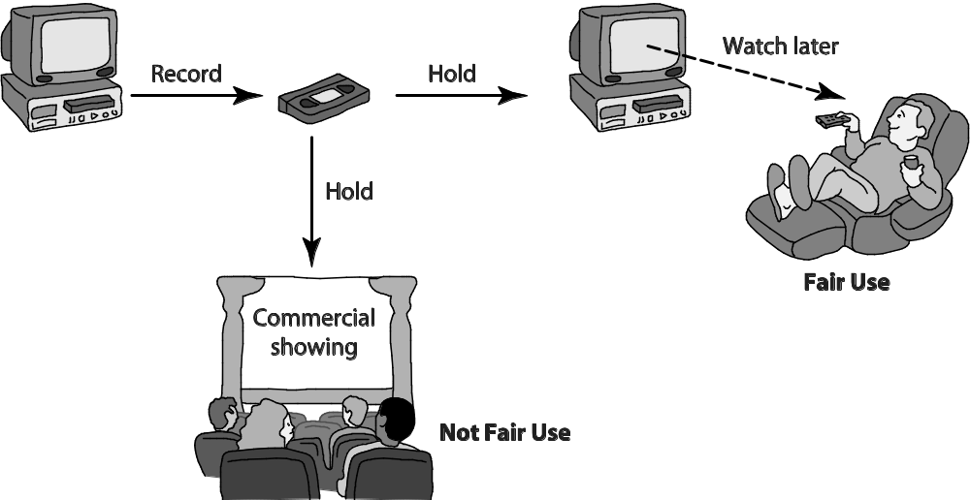
Time Shifting

Slide 46
Fair Use Doctrine
Four factors considered
  Purpose and nature of use – commercial (less likely) or non-profit purposes
  Nature of the copyrighted work – fiction/ non-fiction , published/ unpublished.
  Amount of significance or portion used
  Effect of use on potential market or value of the copyright work (will it reduce sales of work?)
No single factor alone determines
Not all factors given equal weight, varies by circumstance
MPU32213-SE-Oct2017
Notes:
Important – 4 factors in Fair Use Doctrine

Slide 47
Activity: Determine if they made fair use of the material
Scenario 1
A professor puts a few journal articles on reserve in the library and makes them assigned reading for the class. Some students in the class complain that they cannot get access to the articles because other students always seem to have them checked out. The professor scans them and posts them on his Web site. The professor gives the students in the class the password they need to access the articles.
MPU32213-SE-Oct2017
Notes:
1) The ﬁrst factor to consider is the purpose of the use. In this case the purpose is strictly educational. This factor weighs in favor of fair use.
2) The second factor is the nature of the work being copied. The journal articles are nonﬁction. Again this weighs in favor of fair use.
3) The third factor is the amount of material being copied. The fact that the professor is copying entire articles rather than brief excerpts weighs against a ruling of fair use.
4) The fourth factor is the effect the copying will have on the market for journal sales. If the journal issues containing these articles are no longer for sale, then the professor’s actions cannot affect the market. The professor took care to prevent people outside the class from accessing the articles. Overall, this factor appears to weigh in favor of fair use.
Three of the four factors weigh in favor of fair use. The professor’s actions probably constitute fair use of the copyrighted material.

Slide 48
Activity: Determine if they made fair use of the material
Scenario 1
A professor puts a few journal articles on reserve in the library and makes them assigned reading for the class. Some students in the class complain that they cannot get access to the articles because other students always seem to have them checked out. The professor scans them and posts them on his Web site. The professor gives the students in the class the password they need to access the articles.
Scenario 2
An art professor takes slide photographs of a number of paintings reproduced in a book about Renaissance artists. She uses the slides in her class lectures.
MPU32213-SE-Oct2017
Notes:
Scenario 2:
1) The ﬁrst factor to consider is the purpose of the copying. The professor’s purpose is strictly educational. Hence, the ﬁrst factor weighs in favor of fair use.
2) The second factor is the type of material being copied. The material is art. Hence, this factor weighs against a ruling of fair use.
3) The third factor is the amount of material copied. In this case, the professor is displaying copies of the paintings in their entirety. Fair use almost never allows a work to be copied in its entirety. Note that even if the original painting is in the public domain, the photograph of the painting appearing in the art book is probably copyrighted.
4) The ﬁnal factor is the effect the copying will have on the market. The determination of this factor would depend on how many images the professor took from any one book and whether the publisher is in the business of selling slides of individual images appearing in its book.
Overall, this professor’s actions are less likely to be considered fair use than the actions of the professor in the ﬁrst scenario.

Slide 49
New Restrictions on Use
Digital Millennium Copyright Act
Digital Rights Management
Secure Digital Music Initiative
Encrypting DVDs
MPU32213-SE-Oct2017

Slide 50
Digital Millennium Copyright Act
The primary purpose of the DMCA was to bring the United States into compliance with international copyright.
Online service providers that misuse copyrighted materials face severe penalties. That means, for example, a university that knows students are exchanging MP3 ﬁles on the campus network and does nothing to stop them can be sued.
MPU32213-SE-Oct2017

Slide 51
Digital Rights Management
Digital rights management (DRM) can refer to any of a variety of actions owners of intellectual property may take to protect their rights.
One approach to DRM is to encrypt the digital content so that only authorized users can access it.
Another approach is to place a digital mark on the content so that a device accessing the content can identify the content as copy-protected.
MPU32213-SE-Oct2017
Notes:
Digital rights management (DRM) technologies are a collection of techniques that control uses of IP in digital formats.
DRM implementations for various products can prevent saving, printing, making more than a specified no of copies, distributing a file, extracting excerpts, or fast forwarding over commercials.

Slide 52
Secure Digital Music Initiative
create copy-protected CDs and secure digital music downloads that would play only on SDMI-compliant devices.
SDMI was unsuccessful for three reasons:
  before any copy-protection technologies, the number of music ﬁles being copied on the Internet mushroomed.
  SDMI sponsor – start making a lot of money that became more attractive to customers as access to free MP3 ﬁles got easier.
  the digital watermarking scheme was cracked.
MPU32213-SE-Oct2017
Notes:
All copy-protection schemes are quickly cracked.
Once 1 person cracks the protection & uploads a copy to a P2P network, large no of copies will spread all over.

Slide 53
Encrypting DVDs
the contents of the discs are encrypted using a scheme called the Content Scramble System (CSS) developed by Matsushita and Toshiba.
In 1999, 16-year-old Norwegian Jon Johansen wrote a computer program called DeCSS that decoded the CSS encryption scheme. DeCSS enabled him to view DVD movies on a computer running the Linux operating system.
MPU32213-SE-Oct2017

Slide 54
Ways to protect your IP from misuse: copying and sharing
Responses from the Content Industries:
Ideas from the software industries
  Expiration dates within the software
  Dongles (a device that must be plugged into a computer port)
  Copy protection that prevents copying
  Activation or registration codes
  Obtained court orders to shut down Internet bulletin boards and Web sites
  Using decoys to discourage people to download videos and movies
  (ref: http://www.nytimes.com/2004/05/17/business/patents-technique-help-combat-online-piracy-music-uses-decoy-files-that-deliver.html?_r=0)
MPU32213-SE-Oct2017
Notes:
Decoys – lure or bait
Software companies encoded an expiration date in the free sample versions of software
Dongles – a device that the purchaser has to plug into a port on the computer so that the software can run, thus ensuring that the software runs on only 1 machine at a time.
Consumer software publishers use “copy protection” on diskettes to ensure that you cannot copy a diskette or , if you can, the copy will not run.

Slide 55
Peer-to-Peer Networks
Napster
  peer-to-peer network that facilitated the exchange of music ﬁles.
FastTrack (Grokster, Kazaa)
  second-generation peer-to-peer network technology
BitTorrent
  BitTorrent divides a ﬁle into pieces about a quarter megabyte in length. Different pieces of a ﬁle can be downloaded simultaneously from different computers, avoiding the uploading bottleneck .
Legal Action Against The Pirate Bay
Legal Music Service on the Internet
MPU32213-SE-Oct2017
Notes:
P2P – a transient network allowing computers running in the same networking program to connect with each other and access files stored on each other’s hard drives.
FastTrack – popular P2P networks like Grokster/Kazaa use FastTrack technology. Details refer to 4.6.2 of Quinn
Problem – when one peer computer shares a file with another peer computer, the file is transferred at the slower, upload speed rather than the faster, download speed.
BitTorrent – solved the FastTrack problem

Slide 56
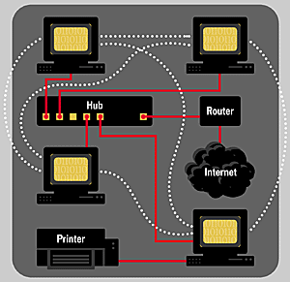
Peer-to-Peer Networks
MPU32213-SE-Oct2017
Notes:
a P2P network operation
The solid lines indicate physical, hard-wired network cables. The dotted lines indicate that each PC can communicate and share files with every other PC on such a network. A printer attached to one PC can be used by other PCs on the network—if that printer’s PC allows such use.

Slide 57
Parties to consider in law
Consumers
  get cheaply and conveniently
Writers, singers, actors
  paid for the time and effort
Entertainment industry, publishers and software companies
  protect their investment and expected revenues
MPU32213-SE-Oct2017
Notes:
Problems of technology’s impact on IPR
Consumers – who enjoy getting movies and music online, the problem is to get cheaply and conveniently
Writers, singers, actors – the problem is to ensure that they are paid for the time and efforts they put in to create IP products that we enjoy.
Entertainment industry – the problem is to protect their investment and expected revenues

Slide 58
Parties to consider in law
Amateur creators
  Reuse without threats of lawsuits.
Academics and advocates
  how to protect intellectual property, but also to protect fair use
MPU32213-SE-Oct2017
Notes:
Amateur - layman, layperson / non professional
Advocates – supporters
Amateur – for those amateur works using works of others, the problem is to continue to create without unreasonably burdensome requirements and threats to lawsuits.
Academics – the problem is how to protect IP, but also to protect fair use, reasonable public access, and the opportunity to use new technologies to provide new services and creative work.

Slide 59
File sharing and hosting sites
Key legal issues
  large scale sharing and exchange of this material
  impact on sales and income of the artists and music companies
  Responsibility of site operators
    Check and eliminate unauthorized copyrighted material
Covers
  Peer-to-peer, torrent tracking, file hosting
MPU32213-SE-Oct2017

Slide 60
Other techniques for protecting
Legal enforcement
  BSA (The software Alliance) monitoring,
  law enforcement raids (by Enforcement Division of the Ministry of Domestic Trade, Co-operative and Consumerism (MDTCC)
Digital rights management (DRM)
  control access to and uses of IP in digital formats
MPU32213-SE-Oct2017
Notes:
DRM – cross reference to Slide 51
DRM implementations for various products can prevent saving, printing, making more than a specified no of copies, distributing a file, extracting excerpts, or fast forwarding over commercials.

Slide 61
Other techniques for protecting
Taxes
  impose a on digital media and equipment to pay copyright holders for losses
  Criticism: make equipment more expensive, penalize equipment makers and honest users unfairly
Copy protection in devices
  Problems: interference, complicate sharing, restrict legal copying, violate freedom
MPU32213-SE-Oct2017

Slide 62
Ethical issues on copyright – Arguments by people
I cannot afford to buy the software.
The company is a large, wealthy corporation.
I wouldn’t buy it at the retail price. The company is not really losing a sale or losing revenue.
Making a copy for a friend is just an act of generosity.
MPU32213-SE-Oct2017
Notes:
Arguments people make in support of personal copying or posting content on Web without authorization
Not being able to afford something does not justify taking it
The size and success of the company do not justify taking something from it. Programmers, writers lose income too when copying is common.
You are taking something of value, getting something for nothing, even if the something is less than the price the copyright owner would charge.
Surely we have a liberty (i.e., negative right) to be the generous, and we can exercise it by making or buying a gift for a friend. It is less clear that we have a claim-right (positive right) to be generous

Slide 63
Ethical issues on copyright – Arguments by people
This violation is insignificant compared to the billions of dollars lost to piracy by dishonest people making big profits.
Everyone does it.
I want to use a song or video clip in my video, but I have no idea how to get permission.
I’m posting this video as a public service.
MPU32213-SE-Oct2017
Notes:
Yes, large scale commercial privacy is worse. That does not imply that individual copying is ethical. And if the practice is widespread, the losses become significant.
The no of people doing something does not determine whether it is right.
This is the better argument than many others. Strict requirements for obtaining permission slows development & distribution of IP.
If the public service is entertainment (a gift to the public), the observations above about copying as a form of generosity are relevant here. Some cases might reasonable fair uses with social value.
i.e., simply posting a complete program, or a substantial portion of one, to share is probably not a fair use.
LAWS ARE NOT ALWAYS GOOD GUIDES FOR ETHICAL DECISION, but the fair use guidelines do a respectful job of identifying criteria to help distinguish fair and unfair copying.

Slide 64
International Piracy
Some countries do not recognize or protect intellectual property
Countries that have high piracy rates often do not have a significant software industry
Many countries that have a high amount of piracy are exporting the pirated copies to countries with strict copyright laws
Economic sanctions often penalize legitimate businesses, not those they seek to target
MPU32213-SE-Oct2017
Notes:
Ignoring foreign copyrights has long been common practice in many countries.
Give an example of country like China.
Chinese government took steps toward reducing privacy. It has increased enforcement of laws.
In China, PC manufacturers used to sell their machines bare, without an OS. This practice encouraged people to buy cheap, unauthorized copies.

Slide 65
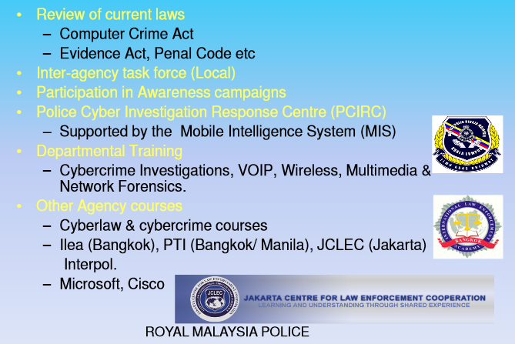
Malaysian Police Initiative in Piracy

Slide 66
Search Engines and Online Libraries
Search Engines
  Caching and displaying small excerpts is fair use
  Creating and displaying thumbnail images is fair use
  Court ordered Google to remove links to pages that infringe copyright; Google is appealing
MPU32213-SE-Oct2017
Notes:
Copying is essential to many search engines.

Slide 67
Search Engines and Online Libraries
Books Online
  Project Guttenberg digitizes books in the public domain
  Microsoft scanned millions of public domain books in University of California's library
  Google has scanned millions of books that are in the public domain and that are not; they display only excerpts from those still copyrighted
Some court rulings favor search engines and information access; some favor content producers
MPU32213-SE-Oct2017
Notes:
Google’s case in Michael Quinn text book

Slide 68
Free-Speech Issues
Domain Names:
Domain names may be used to criticize or protest (e.g. XYZIsJunk.org)
Companies sue under trademark violation, but most cases dismissed
Some companies buy numerous domain names containing their name so others cannot use them
  marypoppinsonbroadway.com, marypoppinstickets.net, marypoppinstickets.org
MPU32213-SE-Oct2017
Notes:
Check domain owner at https://who.is/

Slide 69
Free Software
Free software - idea, an ethic, advocated and supported by large, loose-knit group of computer programmers who allow people to copy, use, and modify their software.
Free means freedom of use, not necessarily lack of cost.
Open source - software distributed or made public in source code (readable and modifiable).
Proprietary software - (commercial) sold in object code (obscure, not modifiable) (E.g.: Microsoft Office).
MPU32213-SE-Oct2017
Notes:
Proprietary software – is normally sold in object code, the code run by the computer, but not intelligible to people. The source code is kept secret.

Slide 70
Free software
allow copy, use, and modification
  Open source (the source code freely available and open to further modification)
Advantages:
  more people to use and benefit
  collaborating programmers can find and fix bugs quickly
  can adapt and improve on existing programs, or create new and better ones.
MPU32213-SE-Oct2017

Slide 71
Open Source
alternative way of distributing software.
Open source characteristics:
  There are no restrictions preventing others from selling or giving away the software.
  The source code to the program must be included in the distribution or easily available by other means (such as downloadable from the Internet).
  There are no restrictions preventing people from modifying the source code, and derived works can be distributed according to the same license terms as the original program.
MPU32213-SE-Oct2017

Slide 72
Open Source
Open source characteristics:
  There are no restrictions regarding how people can use the software.
  These rights apply to everyone receiving redistributions of the software without the need for additional licensing agreements.
  The license cannot put restrictions on other software that is part of the same distribution.
  For example, a program’s open-source license cannot require all of the other programs on the CD to be open source.
MPU32213-SE-Oct2017

Slide 73
Benefit of Open Source
Gives everyone using a program the opportunity to improve it.
New versions of open-source programs appear much more frequently than new versions of commercial programs.
eliminates the tension between obeying copyright law and helping others.
open-source programs are the property of the entire user community, not just a single vendor.
it shifts the focus from manufacturing to service, which can result in customers getting better support for their software.
MPU32213-SE-Oct2017

Slide 74
Examples of Open Source
BIND provides DNS (domain name service) for the entire Internet.
Apache runs about half of the world’s Web servers.
The Android operating system is the world’s best-selling smartphone platform.
Firefox is the most popular Web browser in Europe and the second most popular browser world wide.
Programmers have long recognized the high quality of the GNU compilers for C, C++, Objective-C, Fortran, Java and Ada.
MPU32213-SE-Oct2017

Slide 75
GNU Project and Linux
Pronounced as “guh-new” with the accent on the second syllable.
to develop a complete Unix-like operating system consisting entirely of open-source software.
MPU32213-SE-Oct2017

Slide 76
Patent concepts
Patents protect inventions
  Allow inventor to use in any venture for a specified period of time.
  protect the invention, not just a particular expression or implementation of it.
  The time limit will be 20 years. After that, anyone has the right to make use the ideas.
Rights
  can build and sell the patented device or devices that incorporate the patent
  license others to do so for a license fee
MPU32213-SE-Oct2017

Slide 77
Key differences between copyright and patent software protection systems
 | Software copyright | Software patent
What is protected? | Object program, screen display | Software process with practical utility
Is getting protection expensive? | No | Yes
Is getting protection time consuming? | No | Yes
Is reverse engineering allowed? | Yes | No
Quinn, M. J. (2017). Ethics for the information age. (7th ed.). pp199. Boston: Pearson/Addison-Wesley.
UECS3313-SE-Oct2017
Notes:
What is Reverse Engineering?
While it is illegal to steal a trade secret, there are other ways in which the confidentiality
may be broken.
“Reverse engineering” is one way in which a competing firm can legally gain access to information contained in a trade secret. If another company can purchase a can of Coca-Cola and figure out the formula, it is free to manufacture a soft drink that looks and tastes just like Coke.

Slide 78
Patents - Issues for Software Developers
Patents for Software?
The Supreme Court said that software could not be patented; however a machine that included software could.
Patents are not supposed to be given for things that are obvious or are already in common use.
MPU32213-SE-Oct2017
Notes:
Recall that patents protect inventions of devices and processes.
Software itself is not patentable because it is abstract.
There is much controversy about the standard for obviousness.

Slide 79
Patents - Issues for Software Developers
Patents on Web Technologies:
Amazon agreed to pay IBM who holds patents for online catalogs and targeted advertising
Microsoft was fined $1.5 billion for violating MP3 patents. (http://www.toptechnews.com/article/index.php?story_id=0130010K754H)
Friendster applied for a patent on its social-networking Web techniques. While the patent was pending, sites such as MySpace sprang up. Friendster's patent was granted and it may now charge licensing fees to businesses using the technology.
(https://techcrunch.com/2006/07/07/friendster-awarded-patent-on-social-networking/)
MPU32213-SE-Oct2017
Notes:
Cases from chapter 4, Saraas Base (pp 256)

Slide 80
Arguments against
Stifles innovation
  so many patents that it is difficult to know if new software infringes patents
Discourage small companies
  Cannot estimate costs of research and risk of being sued for new innovations
Patents for common things:
  prices will go up and more incompatible devices
Difficult to determine what is truly original
  distinguish a patentable innovation.
MPU32213-SE-Oct2017
Notes:
From a legal standpoint, software developers must recognize that widely used techniques implemented in software might belong to someone.
They must research patents or consult patent attorneys if they plan to develop products using such technology.

Slide 81
Technology challenges
Storage of text, sound, graphics, video using standardized digital formats
High-volume, portable media
Compression formats that make files small
Search engines
Peer-to-peer technology which permits easy transfer of files
Broadband Internet connections
Miniaturization of recording equipment
Software tools for manipulating video and sound
MPU32213-SE-Oct2017

Slide 82
Scenario #1:
Suppose a company needs to develop a software product that duplicates the functionality of a competitor’s product without violating the competitor’s copyright. If you are the project manager, how do you lead the team in the development?
## use clean room technique/ strategy##
UECS3313-SE-Oct2017

Slide 83
Clean-room software-engineering entails the reengineering of the dirty system beginning with the production of a proprietary-free hand-over specification and its review by a lawyer to assure no proprietary information, copyrighted material or trade secrets are included or relied upon.
UECS3313-SE-Oct2017

